Slide 1


EVERYTHING!
Presented by John Fish
Director Project Support Services
Ford, Bacon & Davis, LLC/S & B Engineers and Constructors, Ltd.
GNOBR Feb 2013 John Fish jrfish@fbd.com

Slide 2

GNOBR 2013 John Fish jrfish@fbd.com

Slide 3
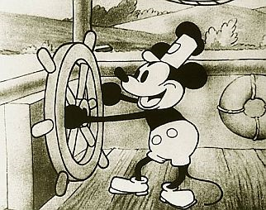

1937 SNOW
WHITE
1930’s Mickey Mouse

Slide 4
RETHINK
EDUCATION: Khan Academy Edx
DEPARTMENT STORES: Apple, jcp
PHONE: Wireless VOIP Smart Remote Control/Access
ENTERTAINMENT: Cable vs. Broadband (Netflix, iTunes)
ENERGY: Cheap Natural Gas – Abundant Oil - Frac
GRID: Decentralized Power Generation
TRANSPORTATION: Driverless Trucks/Cars/Electric
MANUFACTURING: In-Sourcing, Light Out
3D PRINTERS – Decentralized Manufacturing
CONSTRUCTION: Think Manufacturing
ENGINEERING: Discipline Roles, Data Centric
DELIVERABLES: Assembly Instructions
DEFENSE: Iron Dome, Robots, Drones
GNOBR 2013 John Fish jrfish@fbd.com

Slide 5
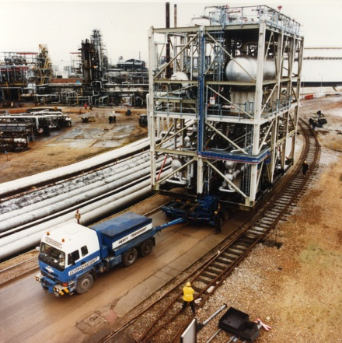
CII – TSUNAMI of PROJECTS
Gulf Coast $165BILLION
SANDY East Coast $90Billion
Alberta, CA $100+Billion
Middle Easts $600-700 BILLION
Not enough engineers/designers
LA – Short 66,000 Craft Workers 2013-14
FAB Shops reaching capacity
Projects will not find staffing
Automation, Pre-Assembly & Modularization will be mandatory
GNOBR 2013 John Fish jrfish@fbd.com

Slide 6
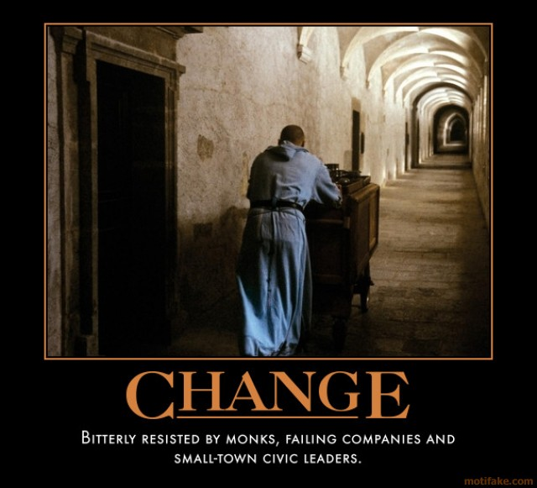
Some Project Managers

Slide 7
RETHINK OUTLINE
WHAT’s New at CII, FIATECH, CMAA
SPEED of Project Delivery
Discipline Roles & Responsibilities
How we use Automation
How we BUY Stuff
How we build things
PM SKILLS of the Future
Document Management & Handover
Construction Assembly Instructions
Work Packaging to increase productivity
GNOBR 2013 John Fish jrfish@fbd.com

Slide 8


What’s New at CII/CMAA/FIATECH
CII: Innovate to meet the demand
Focus on sharing of information and WorkFace Planning
PM/CM Skills of the future
GNOBR 2013 John Fish jrfish@fbd.com

Slide 9
CURRENT RESEARCH TEAMS
252 |  | Construction Productivity Research Program Team (2007 - 2013) (5- to 6-year project)
256 |  | Project Site Leadership Role in Improving Construction Safety - Continuation (2011 • 2012 )
268 |  | Integration of CII Front End Planning Products (2011 - 2012)
272 |  | WorkFace Planning, from Design through Site Execution
280 |  | Methods for Dealing with Uncertainty - Applying Probabilistic Controls in Construction (2010 - 2012)
281 |  | Project Management Skills of the Future - (2010 - 2012)
282 |  | Managing Indirect Costs (2010 - 2012)
283 |  | Modularization (2010 - 2012)
284 |  | Leading Indicators for Safety (2010 - 2012)
290 |  | Quantifying the Impact of Change from Project Authorization to Startup (2011 - 2013)
291 |  | Improving the Accuracy of Project Outcome Predictions (2011 - 2013)
292 |  | Knowledge Transfer from the Near-Retirement Generation to the Next Generation (2011 - 2013)
293 |  | Strategies for HSE Hazard Recognition (2011 - 2013)
294 |  | Deploying Best Practices in Unfamiliar Countries (2011 - 2013)
300 |  | True Impact of Late Deliverables at the Construction Site (2012 - 2014)
301 |  | Using Near Miss Reporting to Enhance Safety Performance (2012 - 2014)
302 |  | Interface Management (2012 - 2014)
303 |  | Managing a Portfolio of Projects-Metrics for Improvement (2012 - 2014)
304 |  | Sustainability Practices and Metrics for the Construction Phase of Capital Projects (2012 - 2014)
305 |  | Measuring Project Complexity and Its Impact (2012 - 2014)
306 |  | Quantitative Measurement of PM Competencies (2012 - 2014)
307 |  | Mitigating Threats of Counterfeit Materials in the Capital Projects Industry (2012 - 2014)
308 |  | Achieving Zero Rework through Effective Supplier Quality Practices (2012 - 2014)
GNOBR 2013 John Fish jrfish@fbd.com

Slide 10
QUESTION POSED to CII BOA
“To really achieve a breakthrough innovation in this industry, we need to …”
“A major innovation would be if we could …”
“What this industry really needs is…”
“To really move this industry forward, our systems and technologies need to…”
GNOBR 2013 John Fish jrfish@fbd.com

Slide 11

Construction must move away from
“the field”
and into
“the factory.”
GNOBR 2013 John Fish jrfish@fbd.com

Slide 12
CONSTRUCTION vs. MANUFACTURING
Environment – weather – unpredictable
Duration – years rather than hours
Repetitive processes rather than 1x
Continuous supply chain
Task-trained people, work in one place, vs.
Craft-trained people who move around
Client involvement
GNOBR 2013 John Fish jrfish@fbd.com

Slide 13
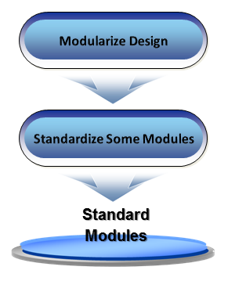
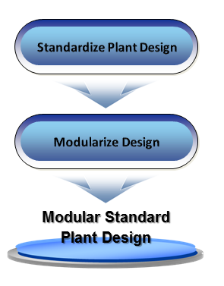
Modularization + Standardization
CII RT-263
GNOBR 2013 John Fish jrfish@fbd.com

Slide 14

Standardization Benefits & Tradeoffs Scale
BUS
EXE
STAN
CSF
ENABLERS
10 Benefits (Mostly Variable Cost Savings)
Design Only Once and Build/Fabricate Many Times
Design & Procure in Advance/Respond to Schedule Needs
Accelerated, Parallel Engineering for Site Adaptation
Learning Curve in Fabrication
Volume Discounts in Procurement
Construction Materials Management Cost Savings
Learning Curve in Module Installation/Site Construction
Learning Curve in Commissioning/Startup (planning & execution)
Learning Curve in Operations & Maintenance
O&M Materials Management Cost Savings
3 Tradeoffs
Cost of Assessing the Market and Establishing Scope (F)
Cost of Establishing the Design Standard (F)
Sacrificed Benefits from Conventional Customization (V)
CII RT-263
GNOBR 2013 John Fish jrfish@fbd.com

Slide 15
Lessons-Learned from Case Studies
CII RT-263
 | Examples of Lessons Learned
Front-End Planning | Team consist of all required disciplines early on, including O&M, construction, purchasing, transportation and key vendors Clearly set boundary conditions on transportation limits and scope limits Promote final design within the organization to avoid rejections during execution Confirm fabrication yard adequacy early
Engineering | Promote repeatability and selection of common materials Have fabricators design more of the tertiary steel
Contracts & Procurement | Integrate vendors early-on in design of modules to ensure technical feasibility
Module Fabrication | QA alignment with the site
Module Transportation | Early transportation studies resulting in clear definition of transportation limits
Module Site Installation | Early involvement of Contractor with module Fabricator/ Vendor Clear installation manuals from vendor
Staffing | All involved parties from Engineering to Installation contractor aligned with the concept of modularization
GNOBR 2013 John Fish jrfish@fbd.com

Slide 16

RETHINK FAST TRACK
What are the common barriers?
Identify Owner/Contractor/Supplier Roles
Identify Risk
Develop a standard to accept and mitigate
OWNERS WANT
Buy
Stuff
Build
Plant
SPEED & TRUST
GNOBR 2013 John Fish jrfish@fbd.com

Slide 17
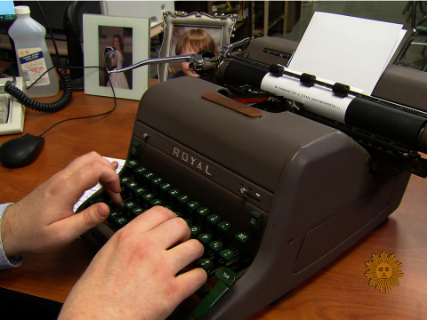

RETHINK AUTOMATION
Millions spent on Technology
No perceived productivity increase
WHY?
Path Forward
GNOBR 2013 John Fish jrfish@fbd.com

Slide 18
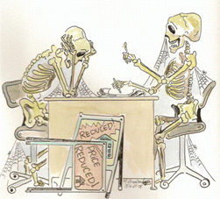
There is nothing so useless
as doing efficiently
that which should not be done at all.
~Peter F. Drucker
Waste is a tax
on the whole people.
~Albert W. Atwood
GNOBR 2013 John Fish jrfish@fbd.com

Slide 19
RETHINK DISCIPLINE ROLES
Work Splits – No change since 1950’s
How we work in a 3D Model
Deliverable Information presentation
Are there OTHER Disciplines?
Role of the Generalists?
GNOBR 2013 John Fish jrfish@fbd.com

Slide 20
RETHINK VENDOR INFORMATION
Develop a Standard
Automate Delivery
Utilize PULL concepts
Automate Delivery to Owner for Life Cycle
QA Documentation Accessibility/Handover
GNOBR 2013 John Fish jrfish@fbd.com

Slide 21
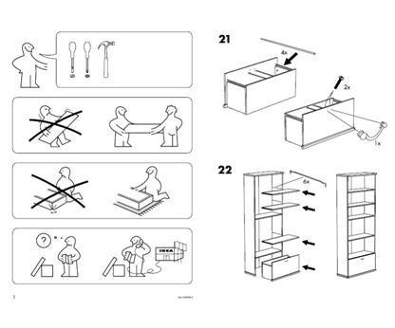
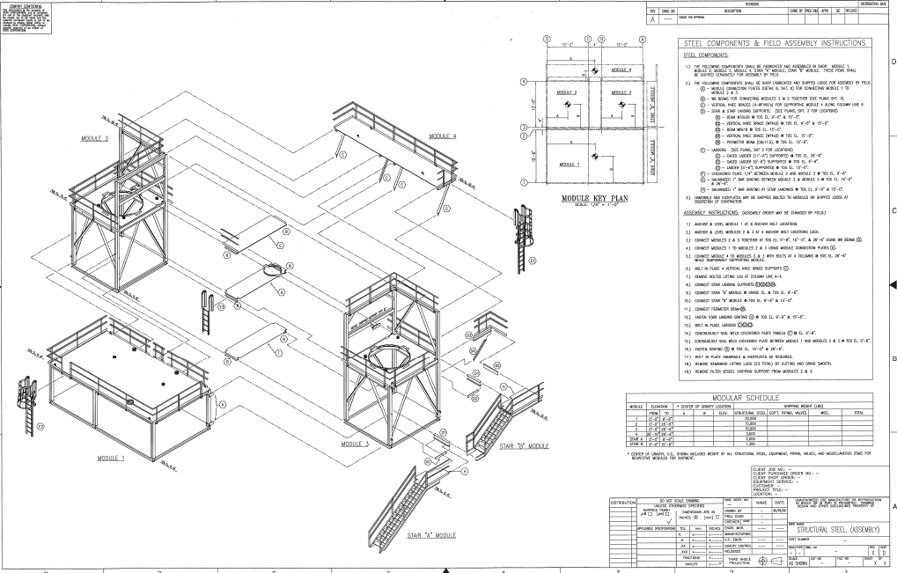
RETHINK DELIVERABLES
Installation Instructions
GNOBR 2013 John Fish jrfish@fbd.com

Slide 22
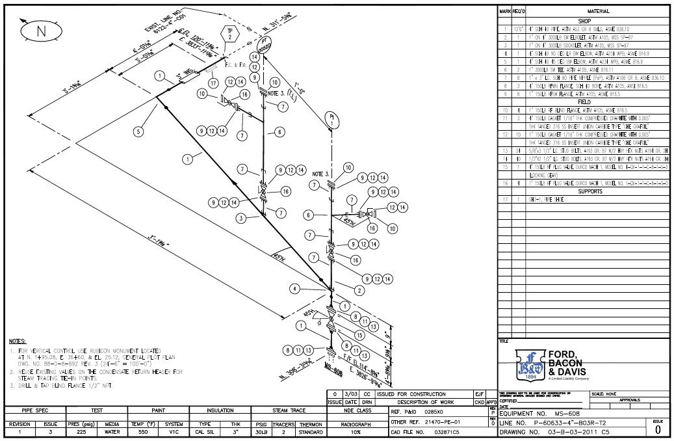
ISO – 1950’s Automated

Slide 23
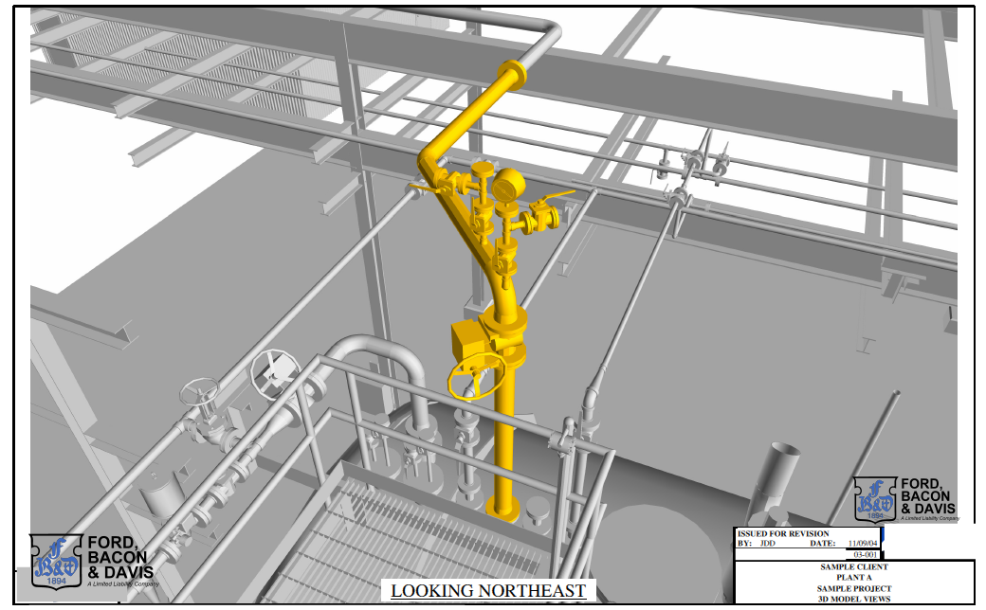
2-SIDED ISO

Slide 24

RETHINK DELIVERABLES
G-3250 Burner Assembly Instructions
GNOBR 2013 John Fish jrfish@fbd.com

Slide 25

RETHINK LEADERSHIP
Influential leadership is critical to success.
Today’s educational system is falling short.
GNOBR 2013 John Fish jrfish@fbd.com

Slide 26
LEADERSHIP –PM/CM SKILLS
Structural leadership vs. influential leadership
  Just being at the top of the org chart doesn’t make you a leader
Real leaders have the influence to make things happen. Who are they? How do we make more?
Emphasis on communication and “people skills” rather than technical expertise.
GNOBR 2013 John Fish jrfish@fbd.com

Slide 27



PM Skills of the Future
Professor Avi Wiezel, Arizona State University
GNOBR 2013 John Fish jrfish@fbd.com
Notes:
Welcome…
I am professor Wiezel and I will be your Master of Ceremonies for the next hour today.
Let me introduce the team that made this event possible <click>

Slide 28
CII CMAA RESEARCH
Project Managers DO NOT
DO REAL WORK!!!!!!!
Create the environment for those you are asking to do real work to succeed
GNOBR 2013 John Fish jrfish@fbd.com

Slide 29
Objectives of the implementation session
1
THINK DIFFERENTLY
There will be a shift in focus from technical and management skills to cognitive and leadership skills
2
LEARN DIFFERENTLY
PM education will require an interactive team setting with a skilled facilitator and will emphasize leadership.
3
MANAGE DIFFERENTLY
The new way of educating PMs can be used to gain insight on the real problems of the organization.
GNOBR 2013 John Fish jrfish@fbd.com
Notes:
29

Slide 30
What got you HERE
Won’t get you THERE
Technically multi-disciplined | TECHNICAL / VIRTUAL
Practical understanding of technology
Possesses keen business insight | MANAGEMENT
Understands project management
Builds knowledge networks
Monitors risk continually
Makes complex decisions | COGNITIVE
Displays emotional maturity
Communicates effectively
Leverages diverse thinking | LEADERSHIP
Builds relationships
Engages others
Mentors people
Builds trust
Future Success
Implementation
Notes:
The first observation is that What got you HERE won’t get you THERE
Implementation at later stages in one’s career – now has to happen earlier.
Builds knowledge networks: Most puzzling new competency. Looks familiar but it is shifting as well. Think about it. The generation that is retiring now had all the knowledge in their heads. They carried one or two fundamental books with them, but it was mostly in their heads. Our generation googles and wikipediazes. The new college graduates don't. Their knowledge providers find the knowledge for them. It is a whole new level of project management. While we have subcontracted the specialized physical skills, the gen y-ers are literarily subcontracting the thinking. They are meta-PMs - Project managers of Project managing. This requires a realignment of the skills.
PMs will have to understand that they are completely dependent on the knowledge of other people. Thy are no longer independent.
<click>
So how will you know what to work on?
Well. AS you may expect, there’s an app for that…<Click>

Slide 31
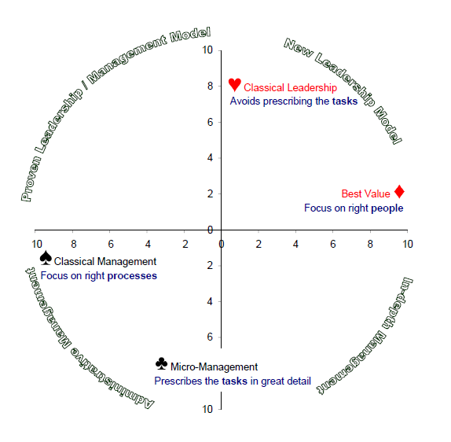
GNOBR 2013 John Fish jrfish@fbd.com

Slide 32
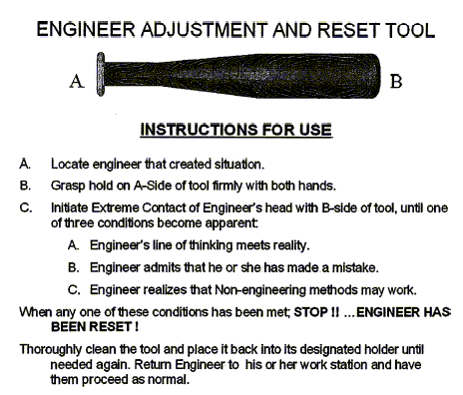
PM

Slide 33
INFORMATION EXCHANGE
STREAMLINE MATERIALS
WORKFACE PLANNING
GNOBR 2013 John Fish jrfish@fbd.com

Slide 34
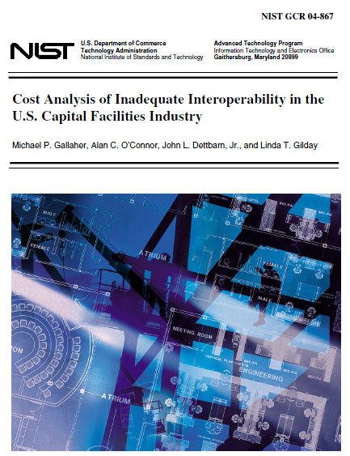
NIST Aug 2004
“The cost of inadequate interoperability in the U.S. capital facilities industry: $15.8 billion per year.”
TWO THIRDS by
OWNER/OPERATORS
TIME LAG to KEYPUNCH - MONTHS/YEARS
GNOBR 2013 John Fish jrfish@fbd.com

Slide 35
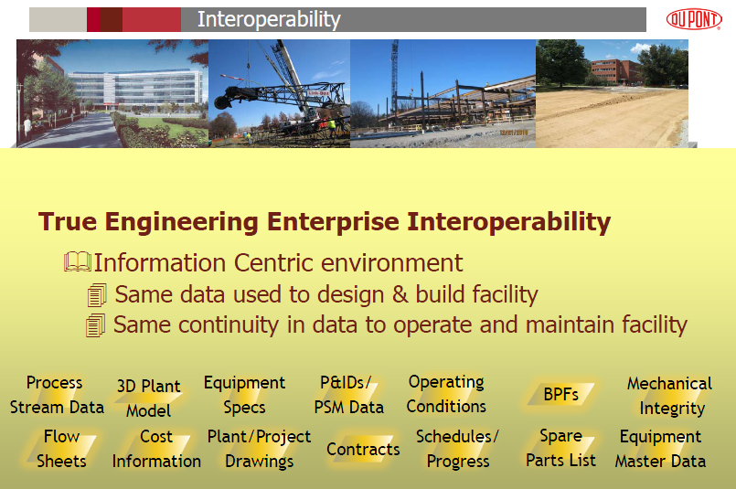
GNOBR 2013 John Fish jrfish@fbd.com

Slide 36
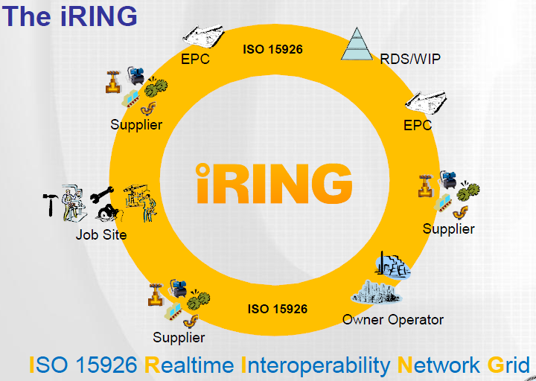
INFORMATION SHARING

Slide 37
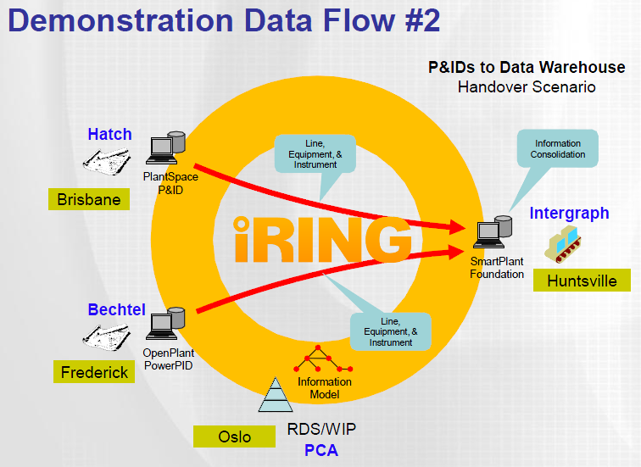
OWNER LIFE CYCLE SYSTEM

Slide 38
Realizing Productivity Improvement Through Integrated Automated Procurement & Supply Networks
Reg Hunter
Sr. Program Director, Fiatech
Hunter@Fiatech.org
512/992-8328
GNOBR 2013 John Fish jrfish@fbd.com

Slide 39
Member Motivation
Study by Marsh showed that the construction industry only invests 0.15% of its costs in materials management and control, versus 1% for the manufacturing industry
Construction Industry Institute (CII) studies have shown that materials and installed equipment can comprise 50-60% of a project’s total cost and control 80% of its schedule
80%
Fiatech members have set Integrated Automated Procurement & Materials Management as a strategic priority
GNOBR 2013 John Fish jrfish@fbd.com

Slide 40
Perspective - Project Costs
Construction
Engineering
Materials & Equipment - 60%
GNOBR 2013 John Fish jrfish@fbd.com

Slide 41
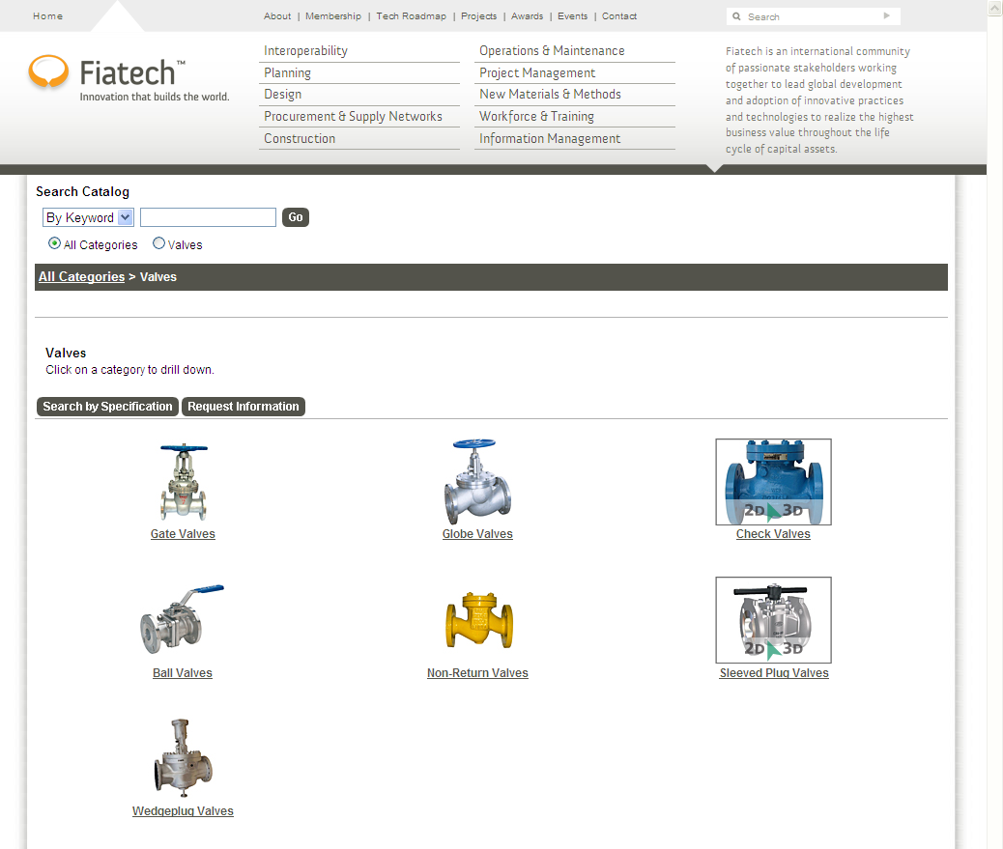
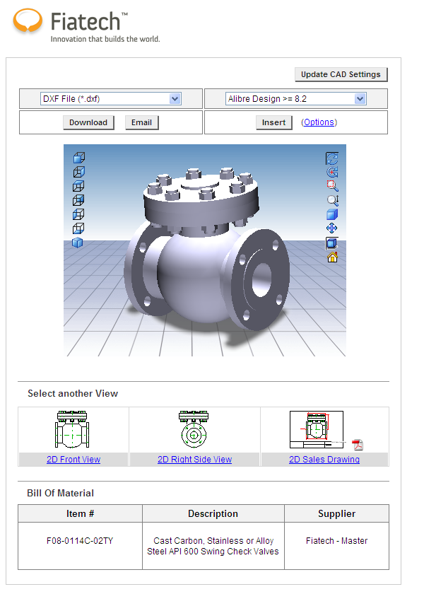
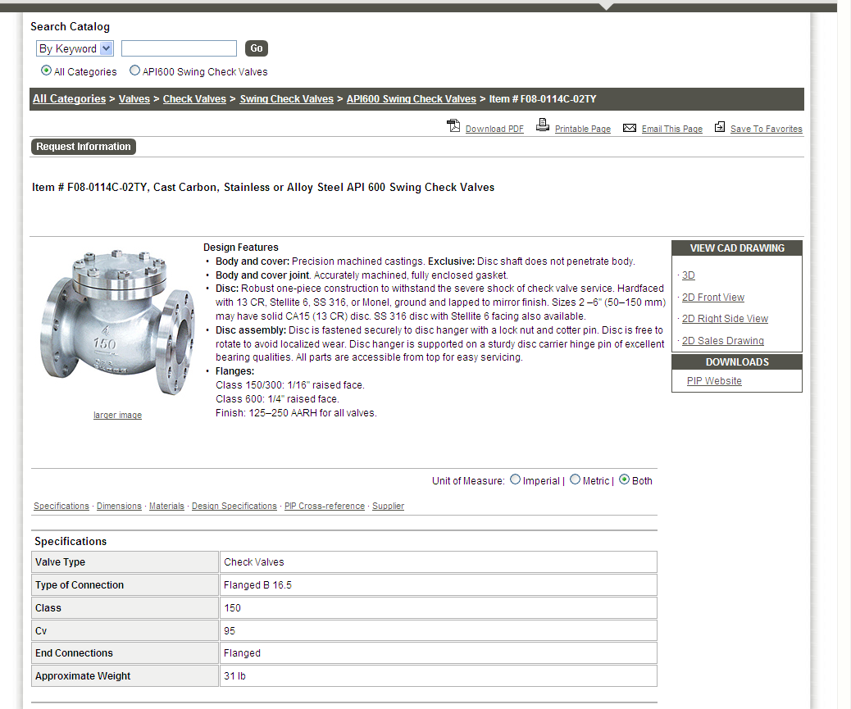
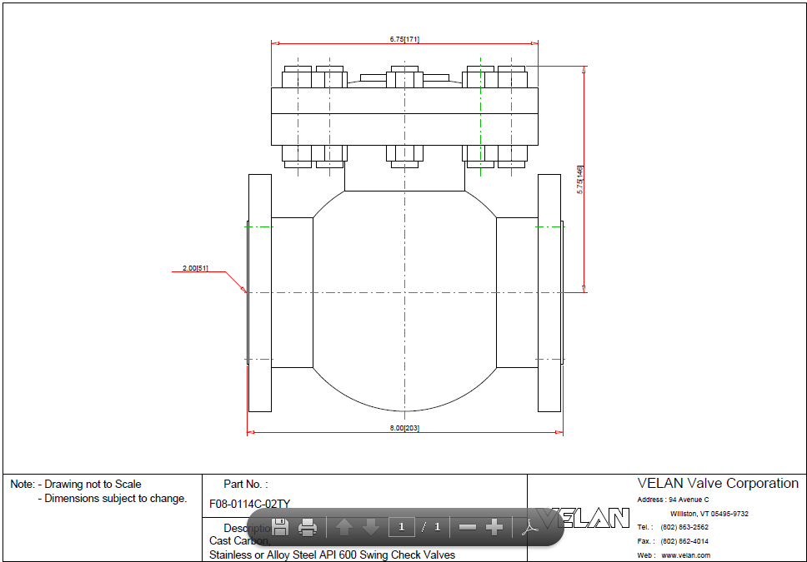
EMSA: Expediting Equipment & Material Selection and Acquisition
eCATLOG PURCHASING
MAKE IT EASY TO BUY
GNOBR 2013 John Fish jrfish@fbd.com

Slide 42
WORKFACE PLANNING
Workface Planning is the process of organizing and delivering all the elements necessary, before work is started, to enable craft persons to perform quality work in a safe, effective and efficient manner, while providing field supervision more ‘boot time’ in the field.
GNOBR 2013 John Fish jrfish@fbd.com

Slide 43
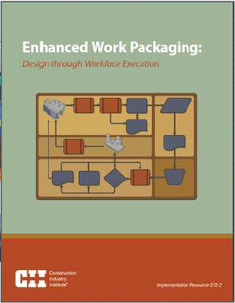

Advanced Work Packaging (AWP)
GNOBR 2013 John Fish jrfish@fbd.com

Slide 44
PRODUCITIVITY RESEARCH
Construction Industry Institute (CII) studies* have shown that 25% to 40% of the construction installed costs is from direct labor.
Enabling Integrated Automated Advanced Work Packaging (AWP) has been identified as the best means to increase productivity, safety, quality, predictability and schedule performance.
Typical workday (8hr) consumption of time
Hours
* IR 252-2A, 2010
GNOBR 2013 John Fish jrfish@fbd.com

Slide 45
IWP PRODUCTIVITY BENEFITS
Elimination of WAIT, TOOLs & Equipment
can POTENTIALLY improve productivity
from 2.2 hours a day to almost 5.
3.0 3.5 4.0 4.5 5.0
Hours
GNOBR 2013 John Fish jrfish@fbd.com

Slide 46

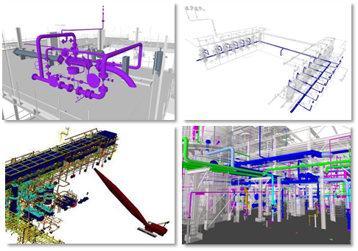








Advanced Work Packaging (AWP) Concept with an Integrated 3D Model
GNOBR 2013 John Fish jrfish@fbd.com

Slide 47

Project Phases Involved in Supporting AWP
Engineering Work Packages
== EWPs
Owner
CWPs ==
Construction Work Packages
Turnover System Packages
Engineer
Construction Management
Fabricator
IWPs ==
Installation Work Packages
Test Packs
Constructor
Engineering
Procurement
Logistics
Shop Fabrication
Site Installation
Systems Testing & Turnover
Commission& Start-Up
GNOBR 2013 John Fish jrfish@fbd.com

Slide 48
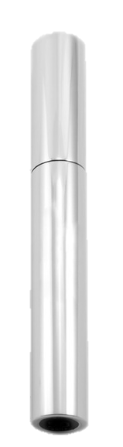

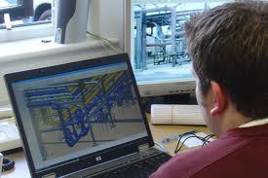

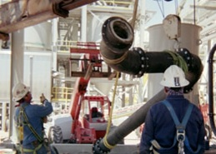
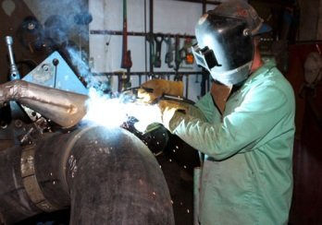
Project Phases Involved in Supporting AWP
Owner
Engineer
Construction Management
Fabricator
Installation Work Packages
Constructor
Engineering
Procurement
Logistics
Shop Fabrication
Site Installation
Systems Testing & Turnover
Commission& Start-Up
GNOBR 2013 John Fish jrfish@fbd.com

Slide 49


“Endpoint” Vision for Advanced Work Packaging
Procurement Packages
Construction Work Packages
Test Packages
System Commissioning Packages
Engineering Work Packages
Installation
Work Packages
System Turnover Packages
Fabrication Packages
PACKAGES REQUIRE INFORMATION EXCHANGE (ISO 15926)
Shop
Detailing
Fabrication Tracking
Doc Mgmt.
CPM Scheduling
Site Materials Mgmt.
Quantity Tracking / EVR
Complete IT
3D CAD
Purchasing Systems
GNOBR 2013 John Fish jrfish@fbd.com

Slide 50
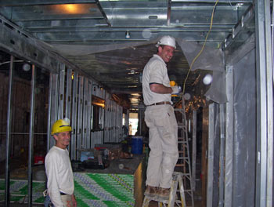
BEGIN with the END in MIND
BUILD
@ FEP THINK
F E P
Develop a project WBS
Align:
Engineering & Construction Work Packages
GNOBR 2013 John Fish jrfish@fbd.com

Slide 51

MANAGE THE FLOW
EQUIPMENT
INFORMATION
TOOLS
MATERIALS
CRAFT
EQUIP
START
FEP
DESIGN
PLAN
FEP
Warehouse
Intelligent Job Site
BUILD
Concrete
STEEL
PIPE
GNOBR 2013 John Fish jrfish@fbd.com

Slide 52
How do we implement
INSTALLATION WORK PACKAGES (IWP) at the job site
GNOBR 2013 John Fish jrfish@fbd.com

Slide 53
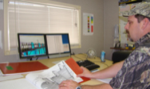
PROCUREMENT/MTLS MANAGEMENT OVERVIEW
PROJECT SUPPLY LEAD Coordinates Engineering/Mtl Control/Procurement
ENGINEERING
Engineered Equipment
CONTROL LISTS
Mechanical Electrical Instrument Piping Specialties
PROCUREMENT
P&ID’s
Manage Inquiries
Bid Tabs
Create Purchase Orders
SUPPLIERS
WAREHOUSE
LAY DOWN
YARD
ENGINEERING REQUISITIONS
VALVES
3D MODEL
Drawings
Isos
EXPEDITE ORDERS
BULK MATERIAL REQUISITIONS
MATERIAL CONTROL
Material & Labor Take Off
All Disciplines
VALVES
IFC LABOR ALLOCATION
CONSTR BUDGET
SOURCE INSPECTION
All NON-MODEL 2D DRAWINGS
SHOP & MTL COORDINATORS
TRIAL ALLOCATION
FIELD PLANNERS
PLOT PLANS, SPECS, STDS
Issue Isos & Steel to Fab Shop
PIPE & STEEL
FABRICATION SHOPS
“Managing with certainty, all the way to the end”
GNOBR 2013 John Fish jrfish@fbd.com

Slide 54
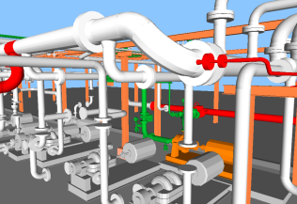
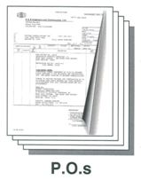
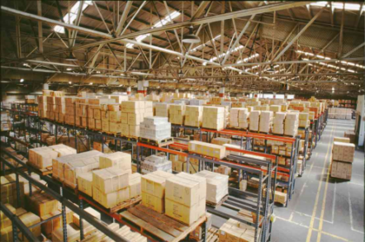
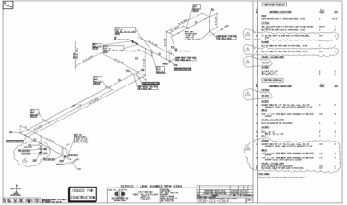




MTLS MGMT – How It Works
Engineering
3D Model
PROCUREMENT
Expediting
Receiving/Warehouse
IFC ISOS Order Shorts
SHOP Coordinator
Fab & Mtl Status Report
Bulk MTL Requisitions
Allocate
Bulks to Isos
THE CONTROLLED WAREHOUSE IS THE KEY TO MATERIAL ACCOUNTABILITY
Isos to Fab Shop
Do we have materials to Support this Work Package?
IFC Labor Control Budget
Engineering
Drawings & Isogen
Materials Management
Material Take Off
IFC ISOS
Warehouse
Bags & Tags Mtls
TRIAL ALLOCATION
All NON-Model 2D Dwgs
Work Pkg
to Crew
Plot Plans, Specs, Stds
WELD Tracking Sys
Check Out Materials to Craftsman
FIELD
PROGRESS
P&ID’s
FIELD CRAFT PLANNER
Manage with certainty all the way to the end.
GNOBR 2013 John Fish jrfish@fbd.com

Slide 55
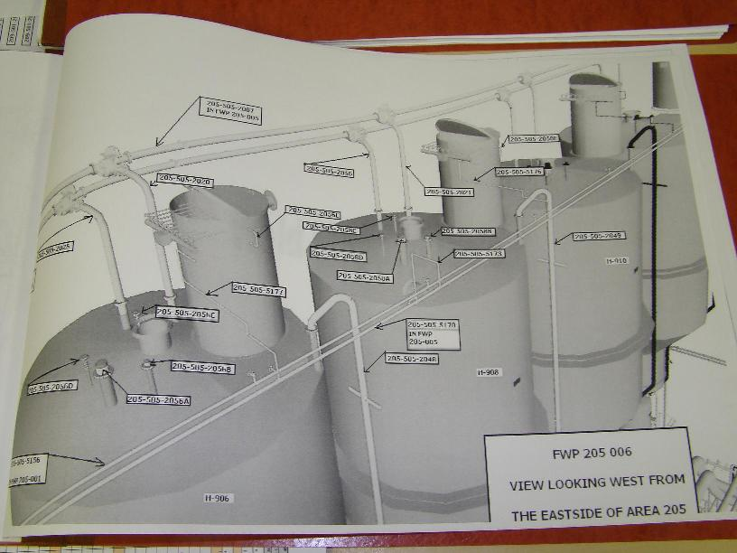
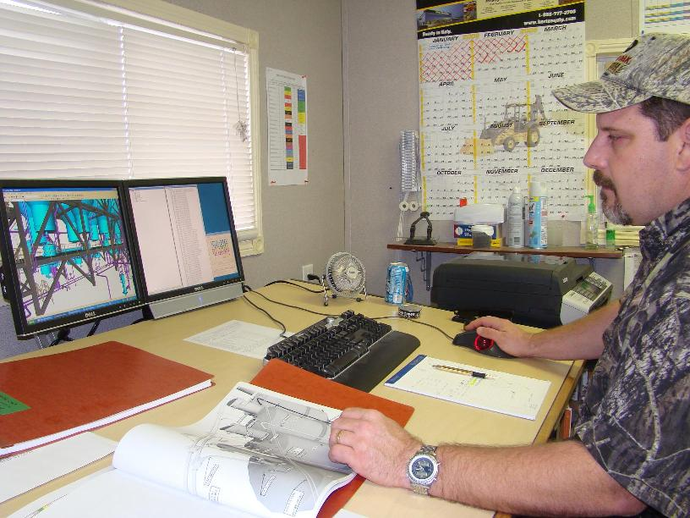
CRAFT PLANNER
Consults P6 Schedule
SELECTS LINES from 3D Model
Work Pkg: 400-1,000 Hrs
Creates “INSTALLATION” Diagrams
“Managing with certainty, all the way to the end”

Slide 56

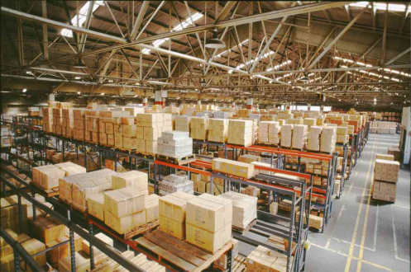
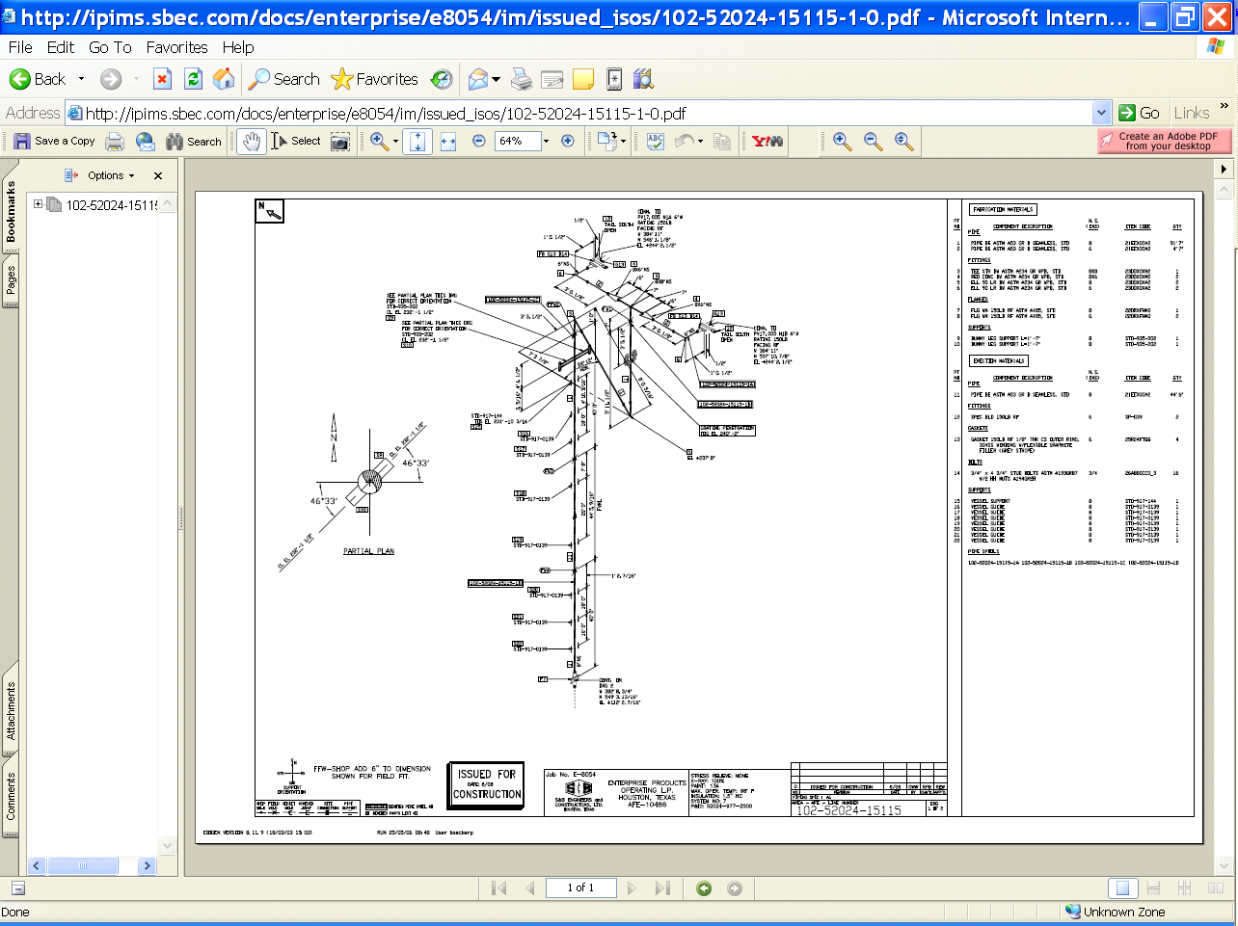
CRAFT PLANNER
Assembles Field Work Plan Book
Drawings, Materials, Weld Info, Line List, Vendor Data, Budgets
Pulls the Isos from iPIMS
Validates Material Availability
Trial
Allocation
Superintendent
Plans supporting Equip, Scaffolding, etc
Instructs Ware to BAG & Tag
Assigns to Foreman
“Managing with certainty, all the way to the end”

Slide 57

Traditional Fab & Erection Iso
THE OLD WAY
4 Isos
“Managing with certainty, all the way to the end”

Slide 58
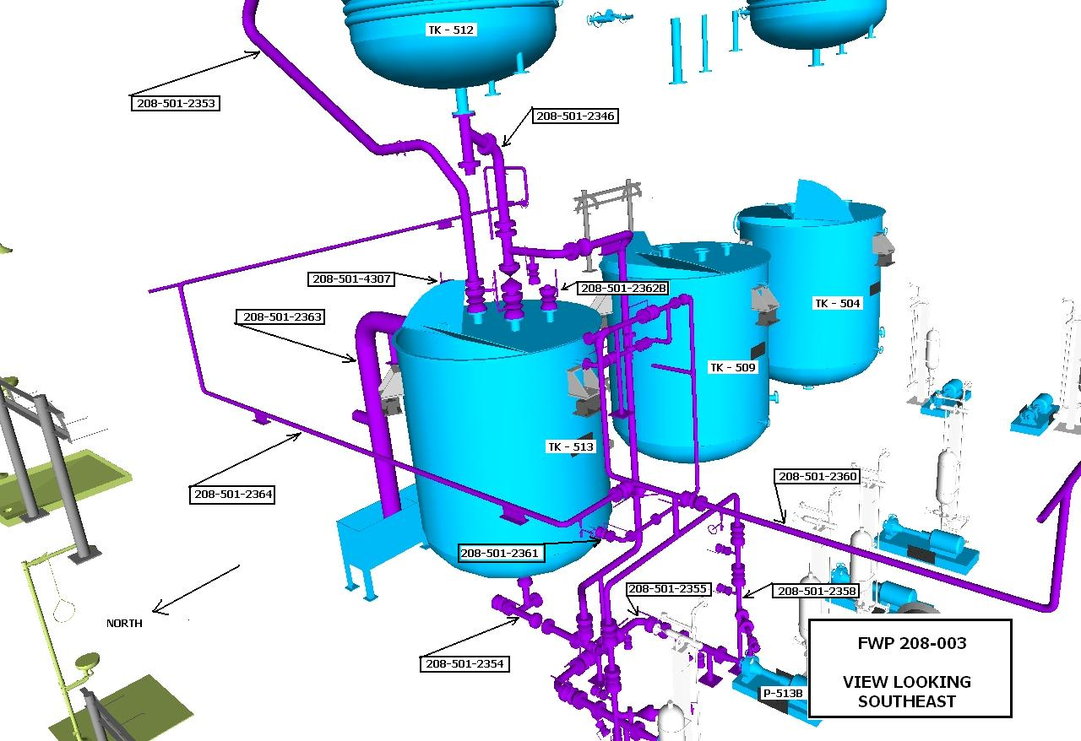
Easy to Read Assembly Views
THE NEW WAY
1 Assembly View
“Managing with certainty, all the way to the end”

Slide 59
First 2 S’s - Last Planner
Craft Planner sorts and sifts info, documents, Mtls, budgets via iPIMS
SORTING
SIMPLIFYING
Erection Views
Everything in PLACE
“Managing with certainty, all the way to the end”

Slide 60
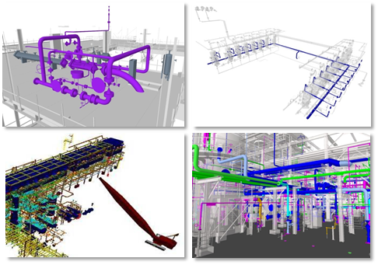

Convergence of Information Resources to Support Holistic AWP
Engineering
Virtual Construction Modeling Tools
Advanced Work Packages (AWP)
Procurement
Fabrication
Logistics
Site Materials
Quality Control
Completions
Construction Work Packages
Installation Work Packages
Module Work Packages
Pipe Test Packs
System Turnover Packages
Project Controls
GNOBR 2013 John Fish jrfish@fbd.com

Slide 61
AWP – Benefits
  Improved labor productivity means improved, more predictable performance.
Seeing up to 25% productivity improvement.
Achieving 4-10% decrease of Total Installed Cost.
Increased productivity improves safety, cost, schedule, and quality.
GNOBR 2013 John Fish jrfish@fbd.com

Slide 62
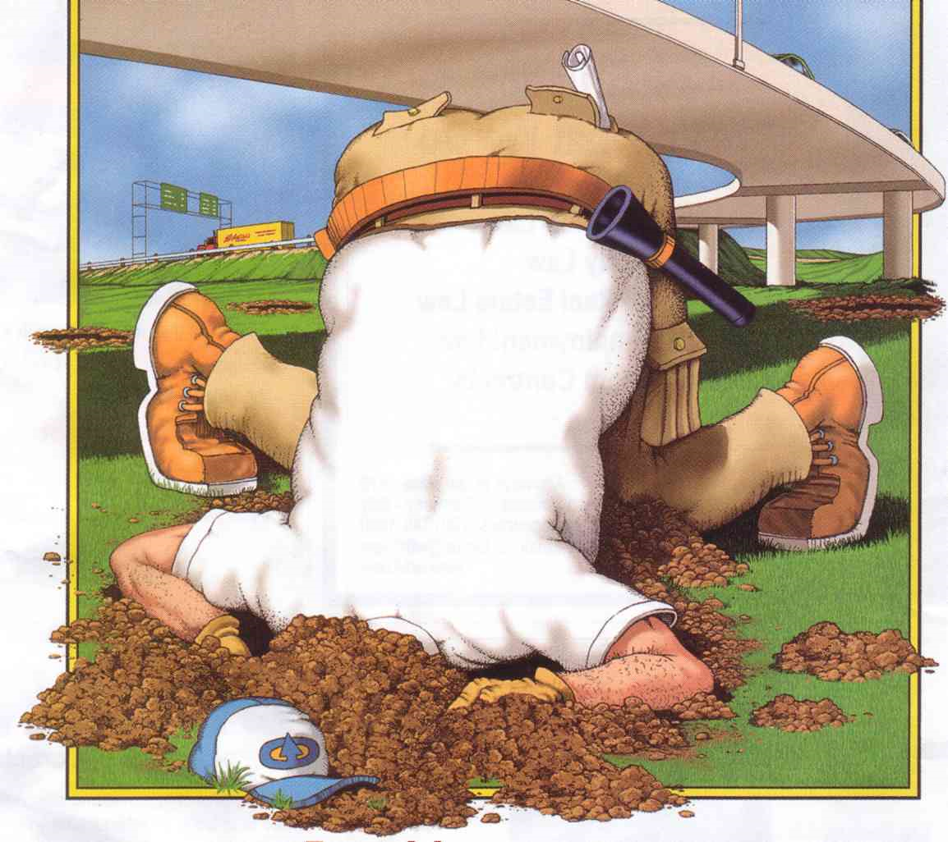
DO NOT IGNORE the IMPACT of CHANGE
GNOBR 2013 John Fish jrfish@fbd.com

Slide 63
RETHINK SUMMARY
Exchange of Information
SPEED of Project Delivery
Discipline Roles & Responsibilities
How we use Automation
How we BUY Stuff
How we build things
Document Management & Handover
Construction Assembly Instructions
Work Packaging to increase productivity
GNOBR 2013 John Fish jrfish@fbd.com

Slide 64




AWP – Related Initiatives
RT 272
RT 263
https://www.construction-institute.org/scriptcontent/rt272.cfm?section=res
Workface Planning – Best Practice
http://www.coaa.ab.ca/Productivity/WorkFacePlanning.aspx
4D/5D BIM
http://www.5d-initiative.eu/
http://www.buildingsmartalliance.org/
WORKFACE PLANNING
Expediting Equipment & Material Selection and Acquisition (EMSA)
GNOBR 2013 John Fish jrfish@fbd.com

Slide 65


We need
THIBODEAUX THINKERS
GNOBR 2013 John Fish jrfish@fbd.com

Slide 66


PAUL HARVEY<
And now for the RRRRRRest of the story.
SUPPORT THOSE WHO REACH FOR THE BANANAS
GNOBR 2013 John Fish jrfish@fbd.com

Slide 67
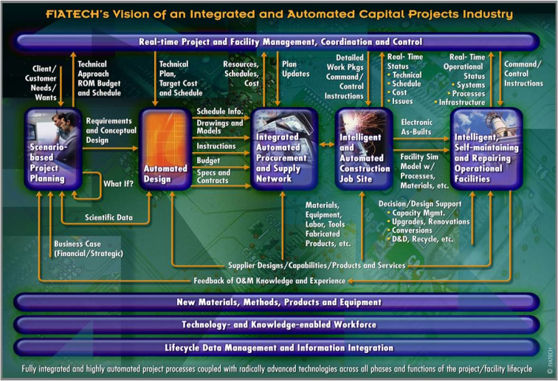
Fiatech’s Roadmap Providing a Holistic Approach to Enabling Productivity Improvement
Fiatech Roadmap
Fiatech Roadmap Elements
Scenario-Based Project Planning
Automated Design
Integrated Automated & Procurement Supply Network
Intelligent & Automated Construction Job Site
Intelligent, Self-maintaining and Reporting Operational Facilities
Real-time Project & Facilities Management, Certification & Control
Information Resource Mapping To Support Advance Work Packaging
New Materials, Methods, Products & Equipment
Technology & Knowledge-Enabled Workforce
Lifecycle Data Management & Information Integration

Slide 68
IWP Motivation
Enabling more effective Installation Work Packaging (IWP) has been identified as the best means to increase productivity, safety, quality, predictability and schedule performance at the construction site.
Construction Industry Institute (CII) studies* have shown that 25% to 40% of the construction installed costs is from direct labor and IWP promises the benefit of up to 25% improvement in field productivity, and a 4-10% reduction in total installed project costs.
Typical workday (8hr) consumption of time
Hours
* IR 252-2A, 2010

Slide 69
Advanced Work Packaging (AWP) Drivers
Enhanced Work Packaging (RT 272)
Workface Planning – Best Practice
& Stakeholders
4D/5D BIM & Information Modeling Requirements

